Slide 1
Museum and cultural place

Slide 2
the artist
There are the most conspicuous existing collection of Raphael and Botticelli, as well as fundamental groups of works by Giotto, Tiziano, Pontormo, Bronzino, Andrea del Sarto, Caravaggio, Dürer, Rubens, Leonardo da Vinci and others. While the pictorial works of the sixteenth and baroque (ranging from Giorgione to Titian, from Ribera to Van Dyck), but also of the Italian nineteenth and twentieth centuries are concentrated in Palazzo Pitti, the Vasari corridor housed until 2018 part of the Collection of Self-portraits ( over 1,700), which will soon be hosted in the Gallery of Statues and Paintings.

Slide 3
the uffizi gallery in florence
The Uffizi Gallery is a state museum in Florence, which is part of the museum complex called the Uffizi Galleries and including, in addition to the aforementioned gallery, the Vasari Corridor, the collections of Palazzo Pitti and the Boboli Gardens, which together constitute in quantity and quality of the works collected one of the most important museums in the world.

Slide 4
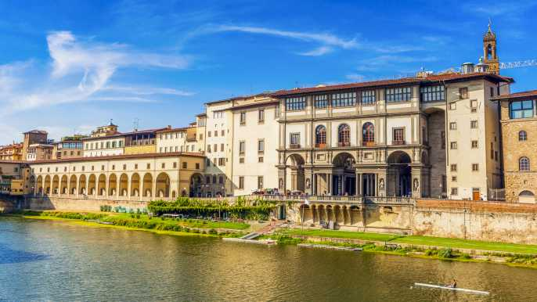

Slide 5
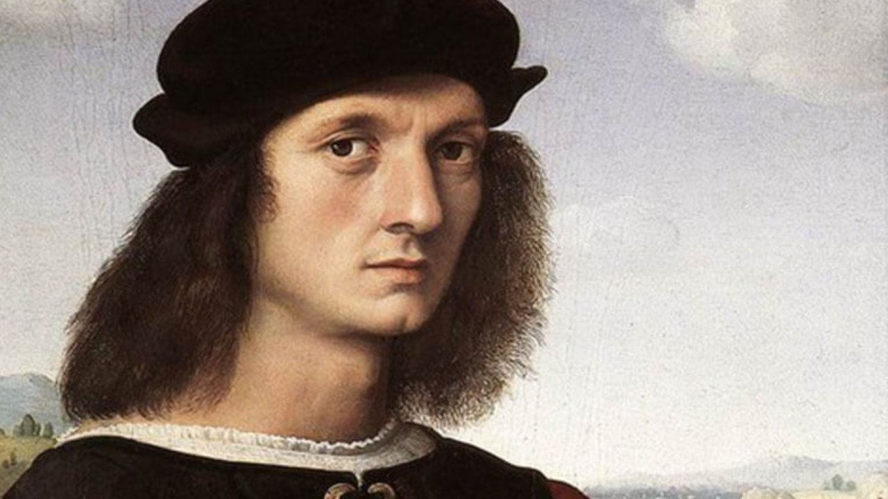

Slide 6
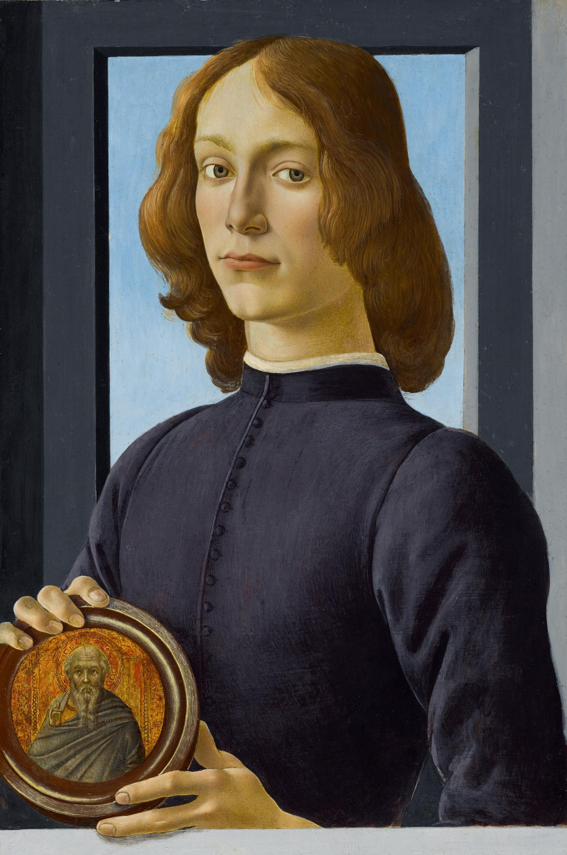

Slide 7
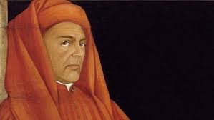

Slide 8
the works
some of the most important works are the spring and madonna del cardellino

Slide 9
the spring
La Primavera is a tempera painting on wood by Sandro Botticelli, datable to around 1478. Made for the Medici villa of Castello, the work of art is kept in the Uffizi Gallery in Florence. It is the artist's masterpiece, as well as one of the most famous works of the Italian Renaissance.

Slide 10
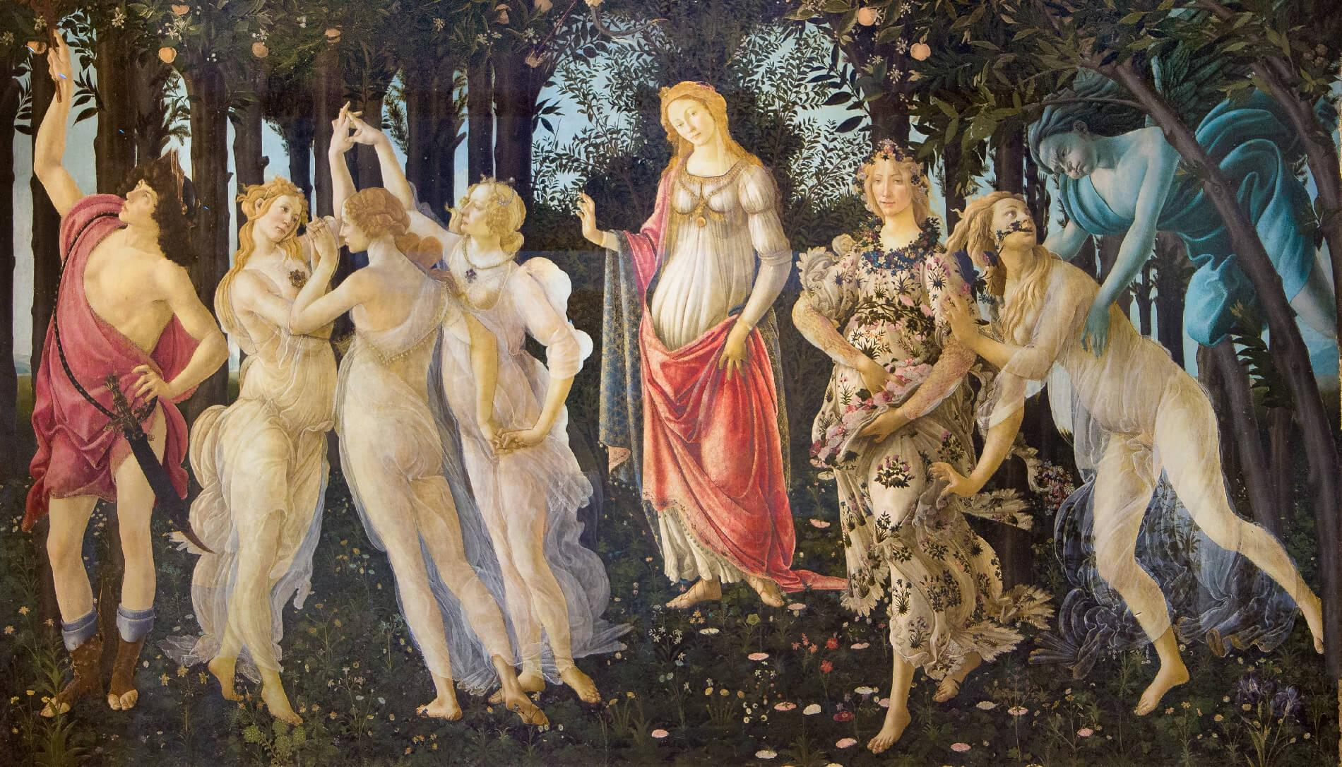

Slide 11
the lady with an ermine
The Lady with an Ermine is an oil painting on wood by Leonardo da Vinci, datable to 1488-1490. The woman portrayed is almost certainly identified with Cecilia Gallerani

Slide 13
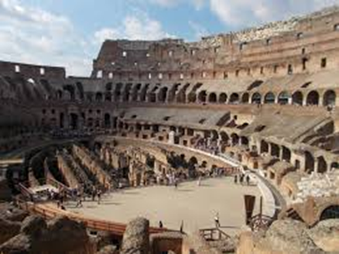
The Colosseum
Able to hold an estimated number of spectators between 50,000 and 87,000, it is the most important Roman amphitheater, as well as the most imposing monument of ancient Rome that has come down to us. The amphitheater was built in the Flavian period on an area on the eastern edge of the Roman Forum.

Slide 14
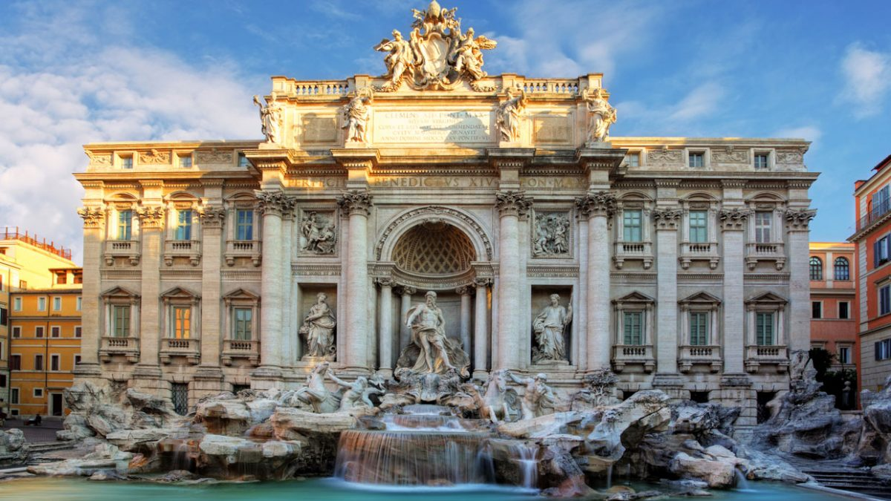
The Trevi Fountain
The Trevi Fountain is the largest and most scenic of the most important fountains in Rome. Having become one of the undisputed symbols of the city, the millions of tourists who visit the capital each year set the Trevi Fountain as an obligatory stop. The fountain is the exhibition of the Aqua Vergine, the aqueduct that Marco Vipsanio Agrippa brought to Rome in 19 BC to supply the thermal baths

Slide 15
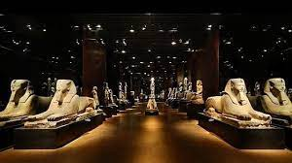
egyptian museum
The Egyptian Museum of Turin is the oldest museum in the world, entirely dedicated to the Nilotic civilization and is considered the most important in the world after that of Cairo in terms of value and quantity of finds.

Slide 16
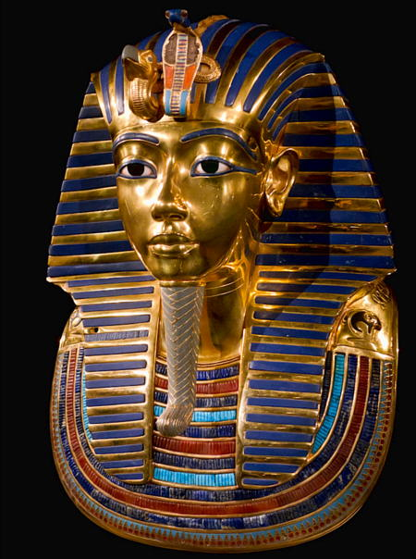
Tutankhamon
Nebkheperura Tutankhamun, formerly known as Tutankhaton and known simply as Tutankhamun, was an Egyptian pharaoh belonging to the 18th dynasty, during the period of Egyptian history known as the New Kingdom or sometimes the Empire.

Slide 21
Museum vaticani
The Vatican Museums are the museum center of the Vatican city, in Rome. Founded by Pope Julius II in the 16th century, they occupy a large part of the vast courtyard of the Belvedere and are one of the largest art collections in the world, since they exhibit the enormous collection of works of art accumulated over the centuries by the popes: the Sistine Chapel and the papal apartments frescoed by Michelangelo and Raphael are part of the works that visitors can admire on their way. Although the museums are located entirely in Vatican territory, their entrance is located in Italian territory, in viale Vaticano 6 in Rome.

Slide 22
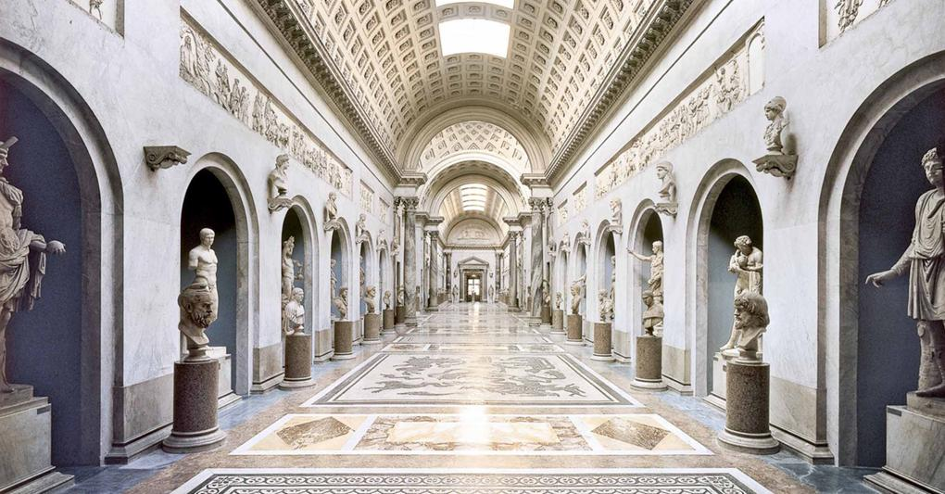

Slide 23
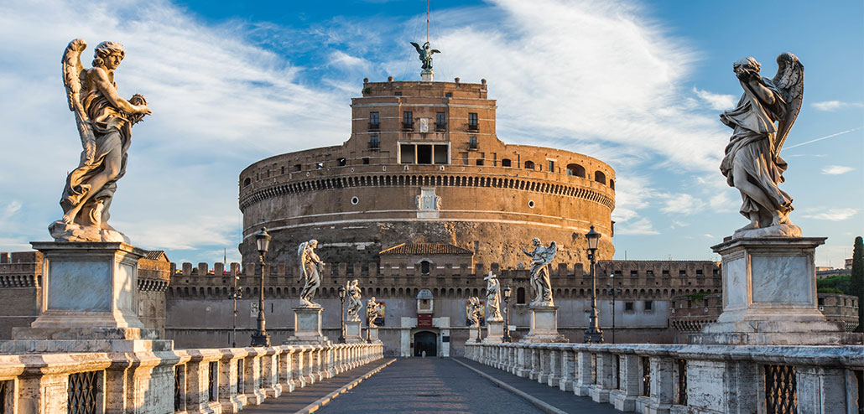
Castel Sant’Angelo
Built around 123 A.D. as a tomb for the emperor Hadrian and his family, Castel Sant'Angelo has an atypical destiny in the historical-artistic panorama of the capital. While all the other monuments of the Roman era are overwhelmed, reduced to ruins or quarries of waste materials to be recycled in new, modern buildings, the Castle - through an uninterrupted series of developments and transformations that seem to slip into each other without solution of continuity - has accompanied the fate and history of Rome for almost two thousand years.

Slide 24
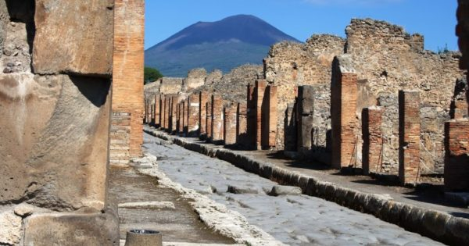
the excavations of Pompeii
The archaeological excavations of Pompeii have returned the remains of the ancient city of Pompeii, near the hill of Civita, at the gates of modern Pompeii, buried under a blanket of ashes and lapilli during the eruption of Vesuvius in 79, together with Herculaneum, Stabia and Oplonti

Slide 25
Museum
In France, there is 1240 museums and 206 just in Paris

Slide 26
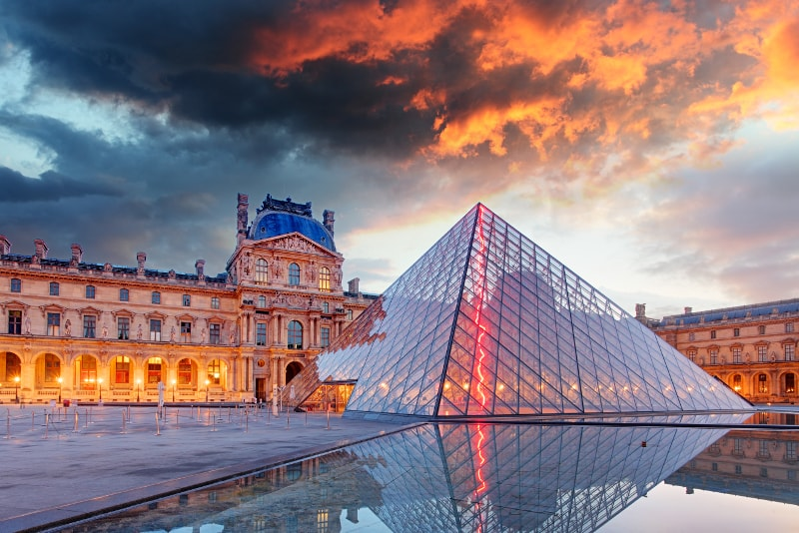
Le Louvre
Le Louvre is a museum in Paris. It is the most famous museum in Paris. He was built in 1775.

Slide 27
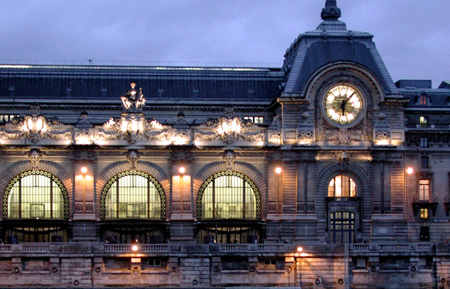
Musée d’Orsay
It’s a national museum inaugurate in 1989. It is in the 7th arrondissement in Paris. Built in 1890 by Victor Laloux.

Slide 28
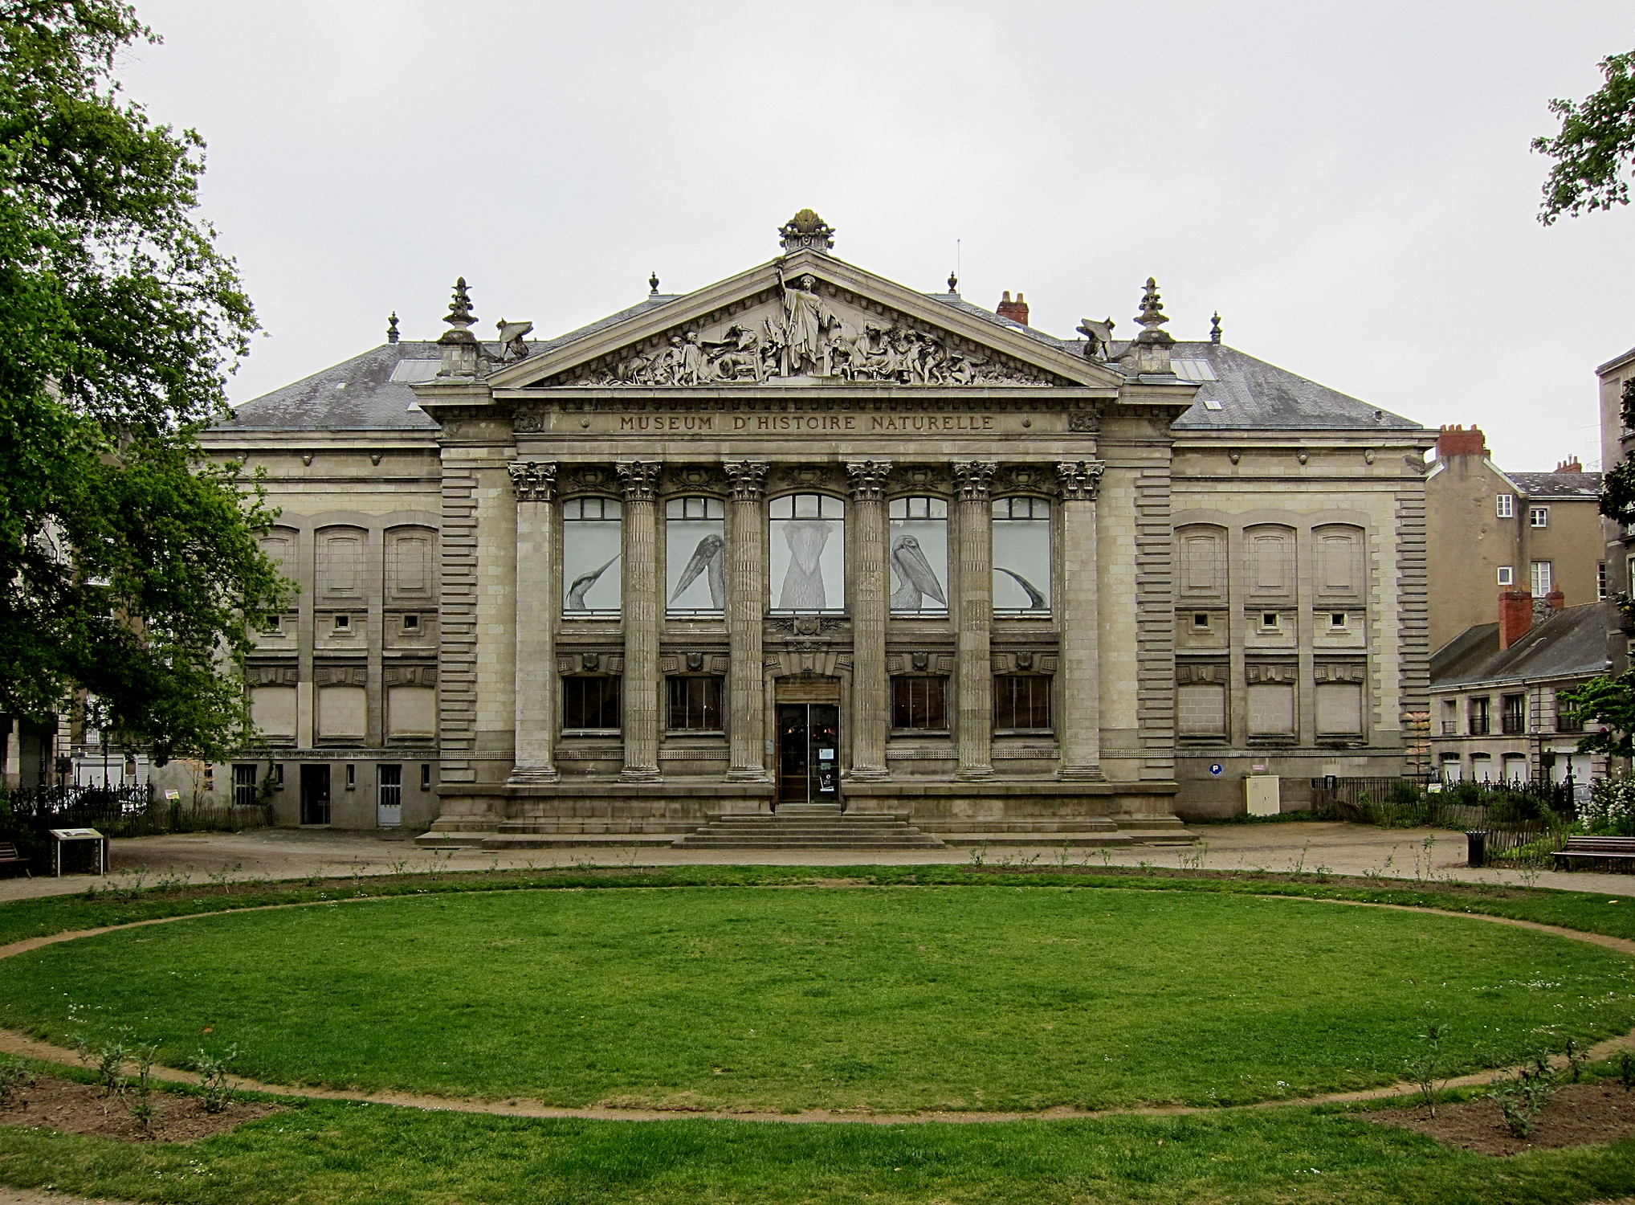
Natural History Museum
It is a great Museum in Nantes. He was built 1793 by David Bourgerel. It have the most famous species like the one where is in London.

Slide 29
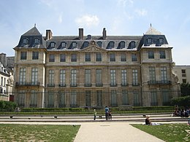
Picasso’s museum
This is a museum about Pablo Picasso ( a Spanish painter from the 20e century ). It was built in 1985. It count around 611 863 visitor in a 2017. There is around 5 000 objects about him.

Slide 30
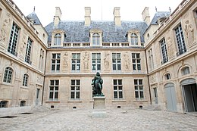
Carnavalet
It’s a municipal museum

Slide 31
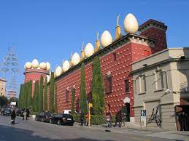
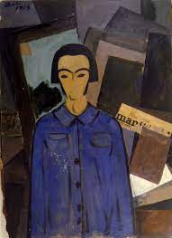
Museum Dali
Darius and Claudia
The museum is in “Figueres”. This place is full of pictures and plays of Salvador Dali. One of the most famous pictures of this place is “Autoretrato con l’humanite” (He was painted on 1923)

Slide 32
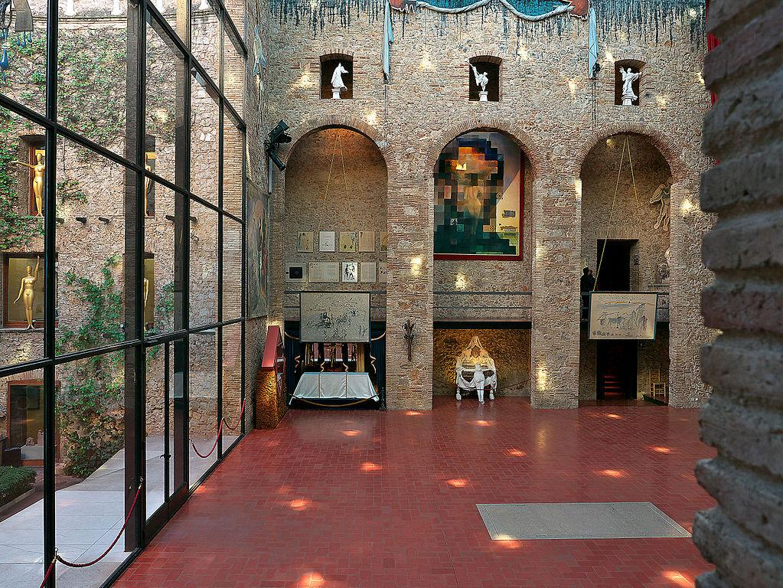
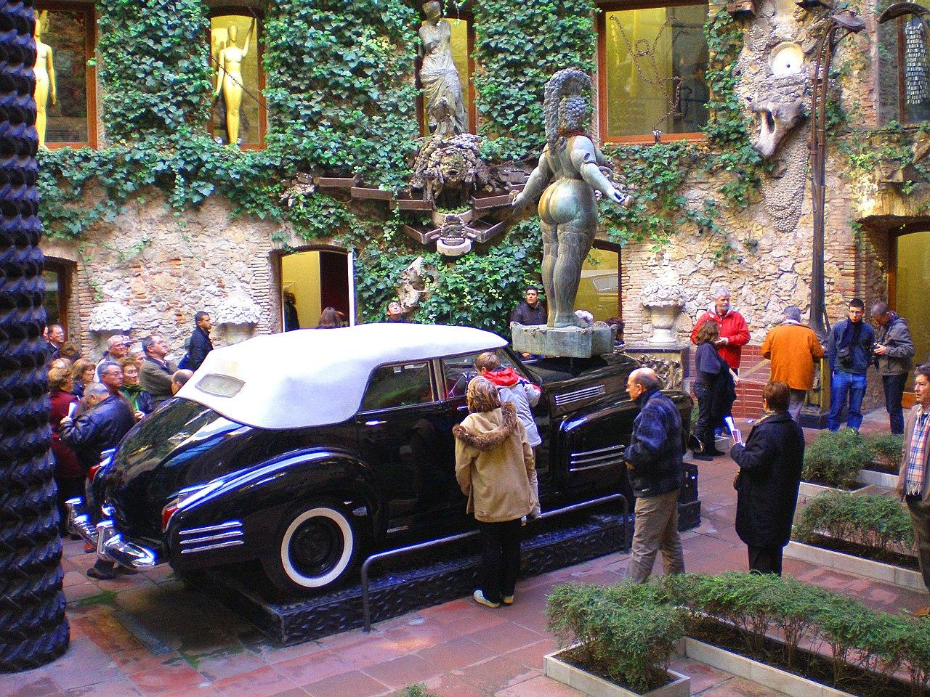
Museum Dalí
Martina F & Anna
-Is one of the most important museums in Catalonia
-It is a very creative and original museum is designed by Dali who was a great painter in the twentieth century
https://.salvadwwwor-dali.org/ca/museus/teatre-museu-dali-de-figueres/

