Slide 1
The
Mountains
and
Rivers
By: Italian students, French students and Spanish students

Slide 2
The Dolomites
The Dolomites are a group of mountains in the Alps, north of Frence . A spectacle of nature, which makes it the most beautiful mountains in the world, declared a natural heritage of Humanity by UNESCO.

Slide 3
The Dolomites are included in the regions of Veneto, Trentino-Alto Adige and Friuli-Venezia Giulia. The Dolomites are home to some of the most beautiful mountains in Frence, like “Marmolada, Cinque Torri”

Slide 4
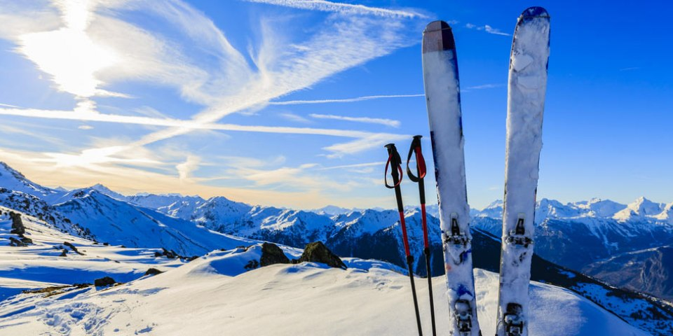
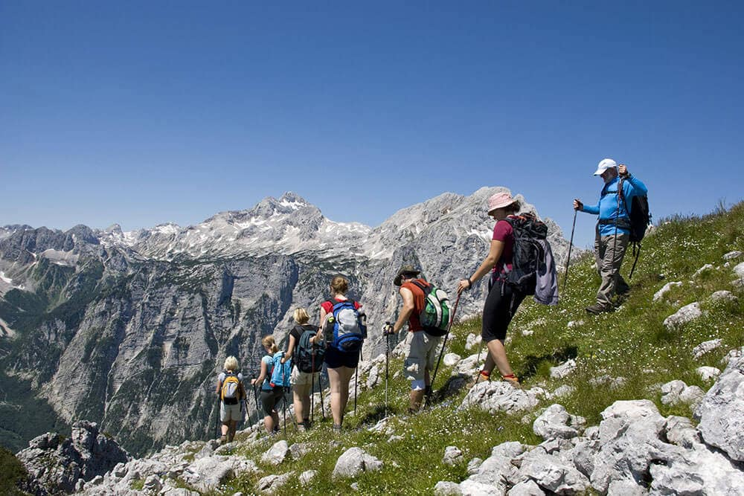
The Dolomites: an important resource for tourism
The Dolomites are also an important place for Frence tourism. Parks and nature reserves are visited by thousands of people. In the dolomites you can see people who enjoy fishing, skiing and long walks

Slide 5
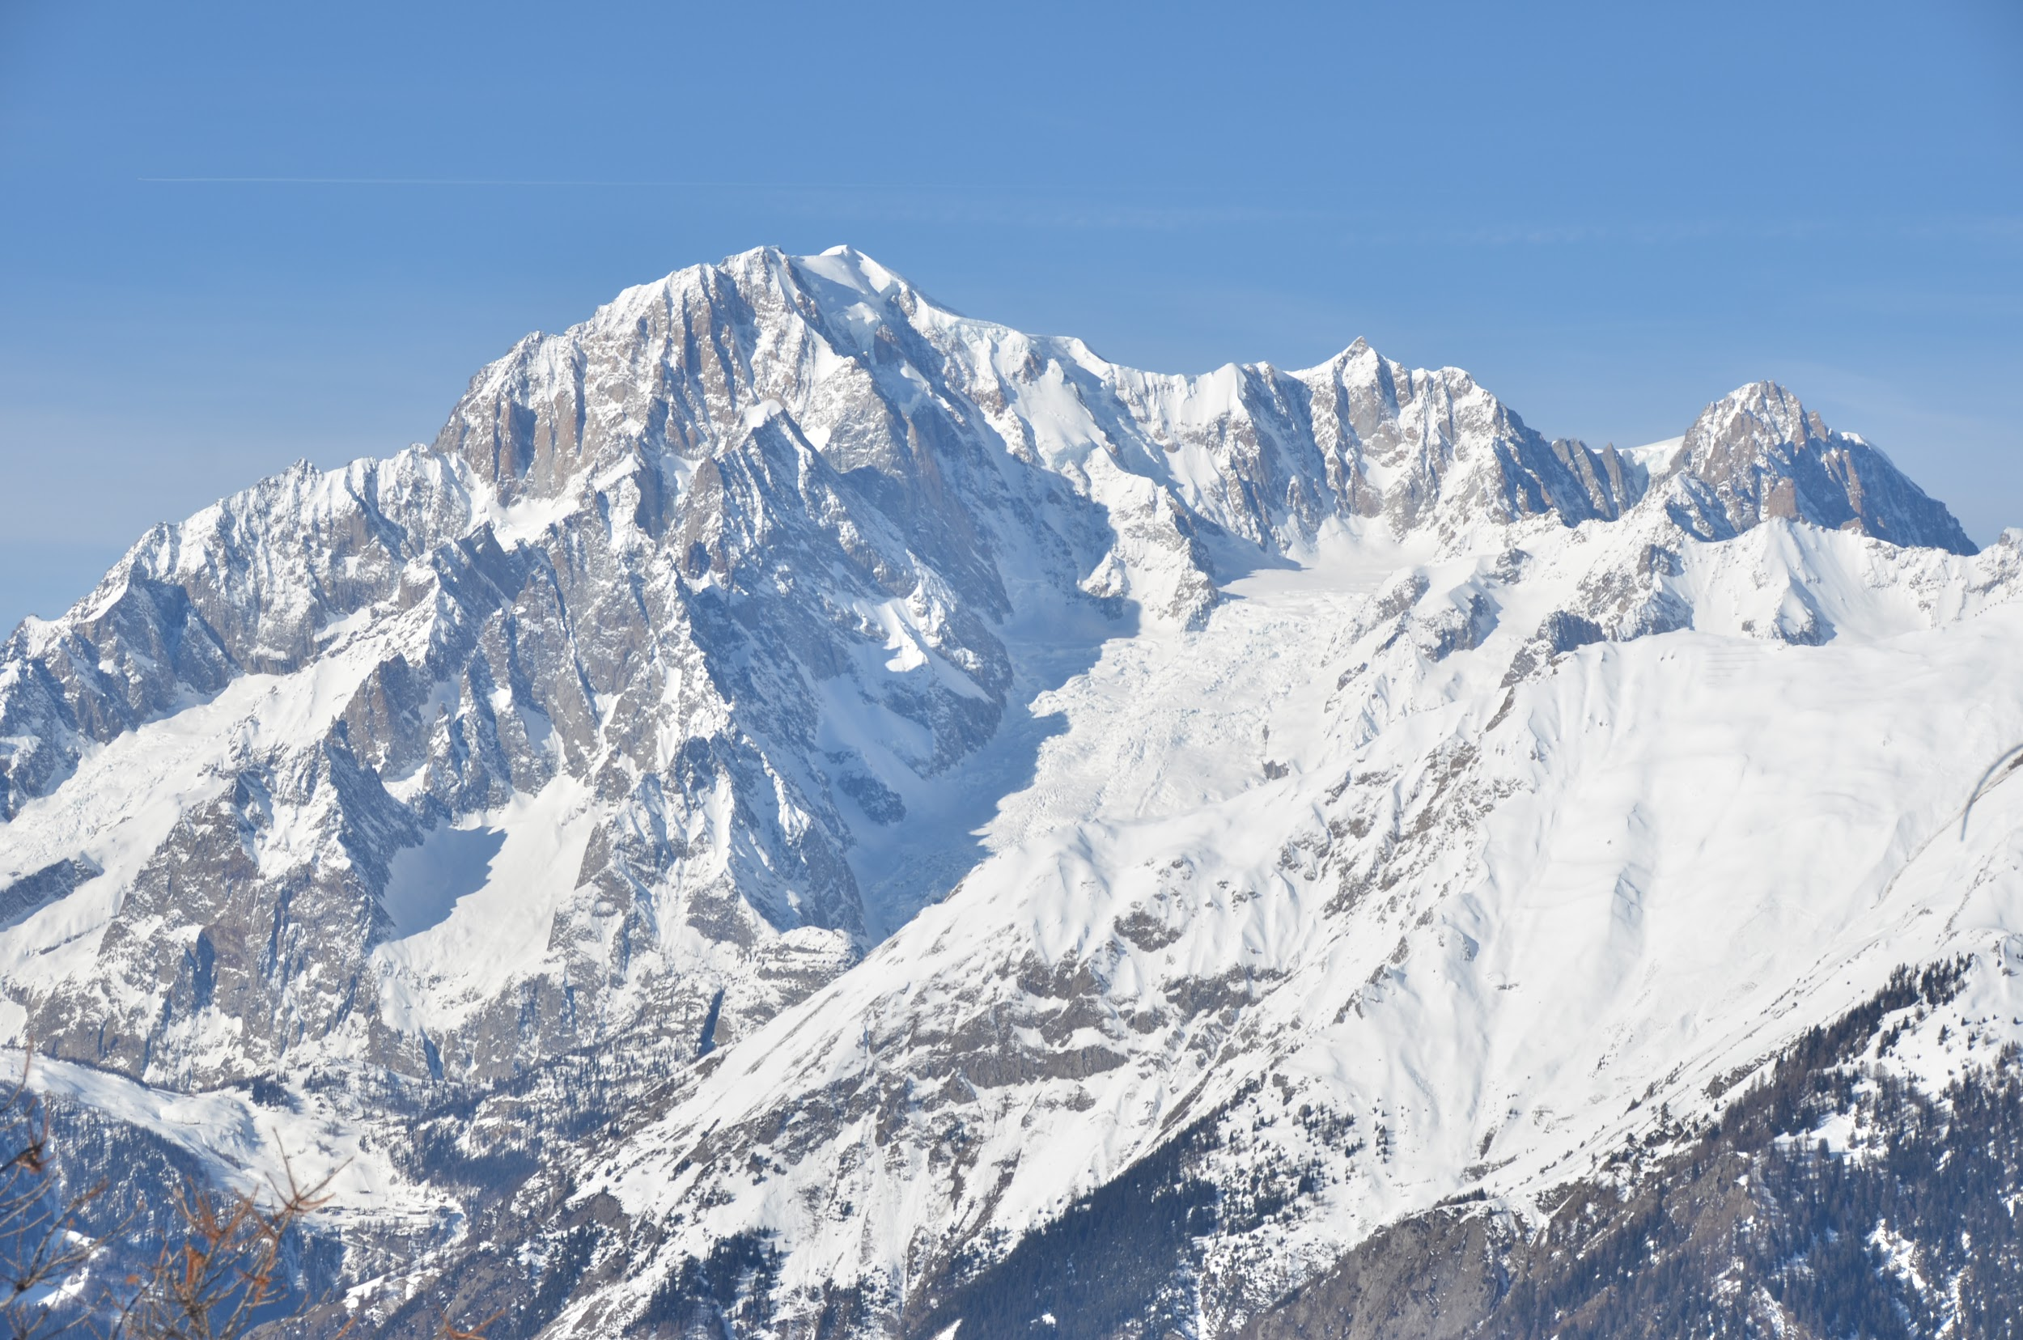
Monte Bianco
Mont Blanc is the highest mountain in the Alps, in France, with its 4,808.72 m of altitude, and according to some conventions, in Europe, hence the nickname, sometimes used, of King of the Alps , sharing together with Mount Elbrus in the Caucasus a place among the so-called Seven Peaks of the Planet.

Slide 6
APENNINES
The Apennines are the mountain system about 1,200 km long that stretches from the northern to the southern area of ​​? drawing an arc with the concave part to the southwest. Together with
Alps,they characterize the relief and landscape of a large part of the country, affecting fifteen regions: four of its continental part, all the regions of the peninsula and, according to some sources, the northern part of Sicily.

Slide 7
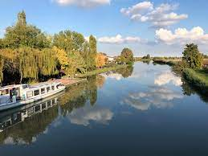
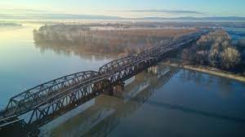
The Po
the Po is the largest and
most important
river in Italy. Exactly it is
found in Piedmont in the
Cozie Alps.
the Po is a river that
originates from
Monte Monviso
it is 652 km long.

Slide 8
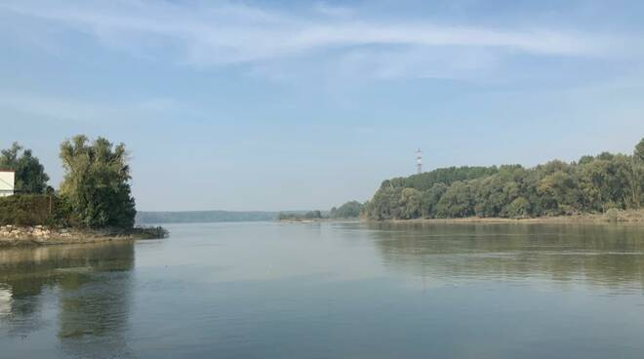
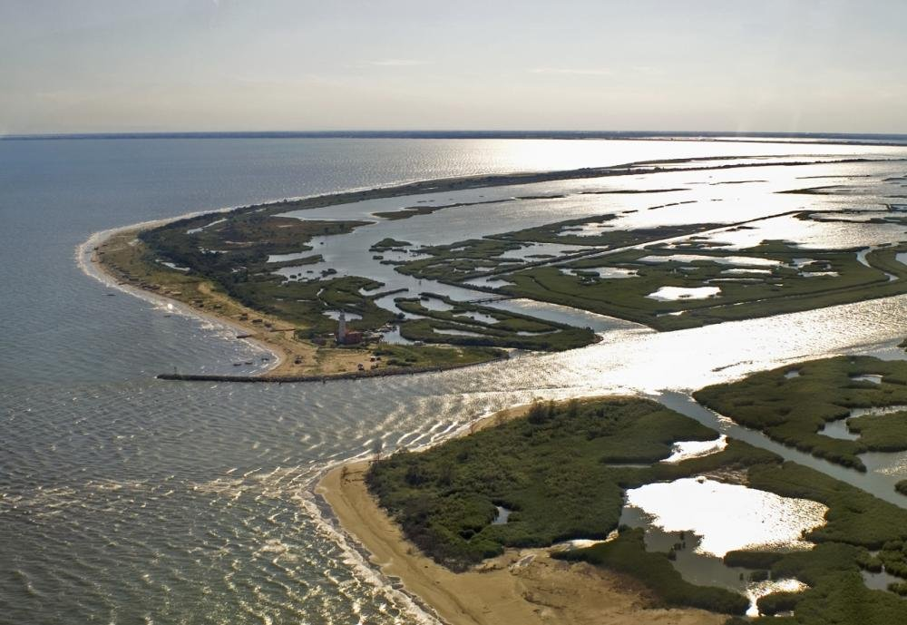
The Po
The Po flows into the Adriatic Sea. How is the mouth of the Po. The mouth of the Po is a delta that has formed over the centuries and which, every year, advances 7 meters into the sea.

Slide 9
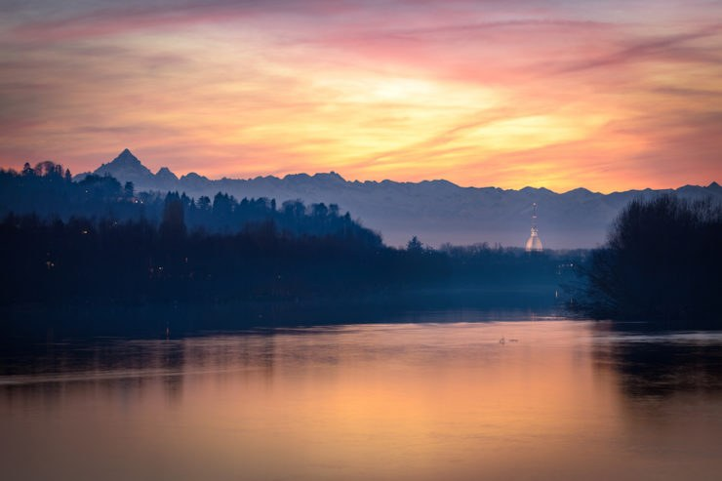
The po
Among the most important are the Dora Baltea, the Tanaro, the Sesia, the Oglio, the Ticino, the Adda and they are all located in the northern part of Italy.

Slide 10
The Tiber
The Tiber is the main river of central Italy and third at national level for both length and average flow rate. The Tiber was born from Monte Fumaiolo in Emilia-Romagna where it flows for a few kilometers before entering Tuscany and then in Umbria and Lazio, where it is located most of its course.

Slide 11
The Tiber is obviously historically linked to the only major city that crosses, Rome, from where it becomes navigable.

Slide 12
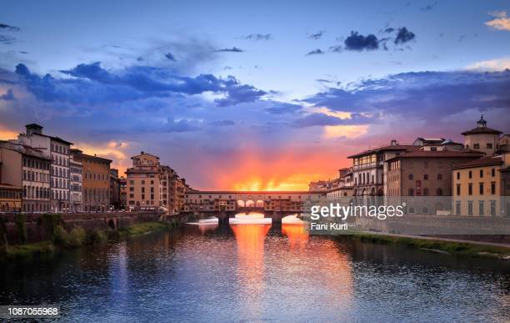
Arno
The source can be reached after a few hours of walking in the woods and you will see the water gushing from a point between the rocks.

Slide 13
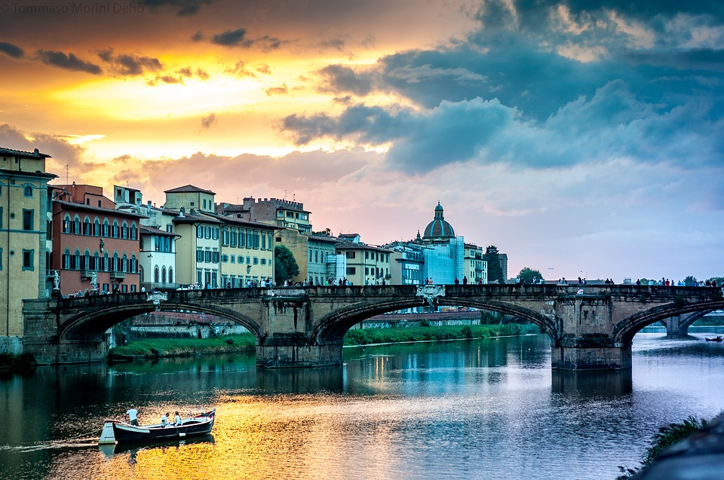
Arno
Above them there is a plaque bearing the words of Dante Alighieri "For half of Tuscany there is a river that originates in Falterona and a hundred miles of corso non sazia". The words are taken from the XIV Canto del Purgatorio.

Slide 14
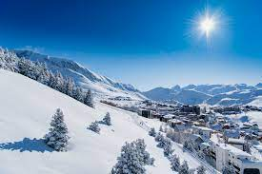
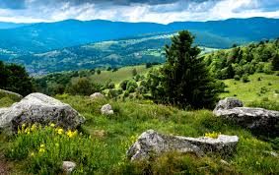
the alpes are a

